Slide 1
BRANCH SERVICE TOOLS
PHASE 1:
Frontend setup
Backend Setup
Devops Structure for frontend
Devops Structure for Backend

Slide 2
FRONTEND SETUP AND STRUCTURE
REQUIRED SOFTWARE
NodeJS and NPM
Vs Code Editor
React js and React Dom
AWS
Jenkins
Github
PHASE 1 Status
Frontend React environment Setup Done
Github integration and Webhooks with Jenkins Done
Jenkin integration Done
Aws Integration (EC2 instance, S3 Bucket, Cloudfront) Done
KYC Ocr and Face Match Dashboard Done
Mobile Authentication Dashboard Done
Email Authentication Dashboard Done
Bank Authentication Dashboard Done
Pan Authentication Dashboard Done
POLICY AMENDMENT FORM B Done

Slide 3
BACKEND SETUP AND STRUCTURE
REQUIRED SOFTWARE
NodeJS and NPM
Vs Code Editor
Nest js
MongoDb
PM2
AWS
Jenkins
github
PHASE 1 Status
Backend Nest Js environment Setup Done
Github integration Done
MongoDb Integration Done
Karza Api Wrapper Pending
AWS Integration Pending
Jenkins Integration Pending
PM2 Integration Pending

Slide 4
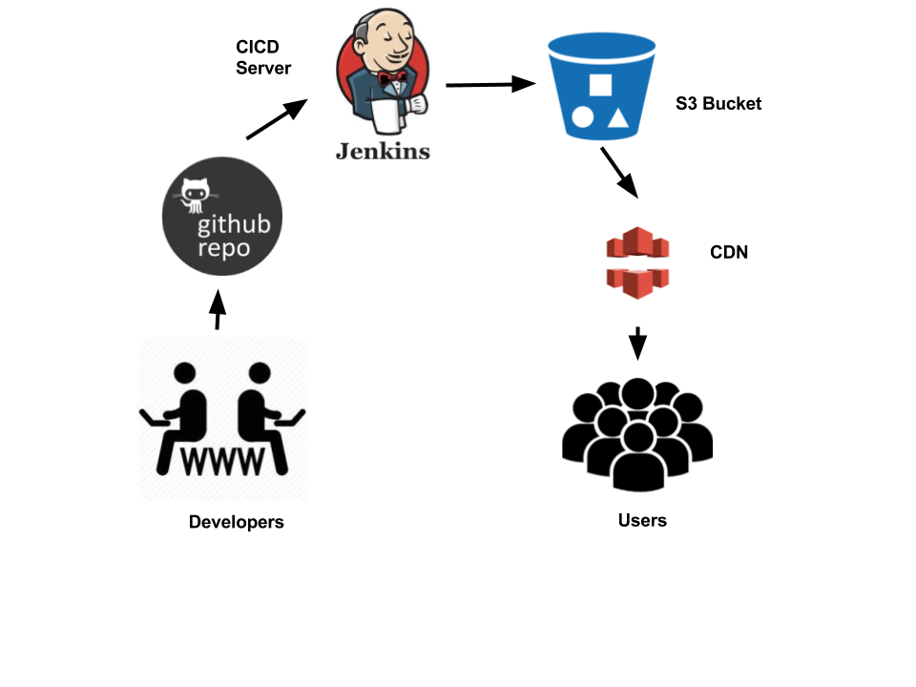
DEVOPS STRUCTURE FOR FRONTEND
Software
Github (Source Code)
Jenkins(CI/CD)
AWS(EC2,S3 Bucket,Cloudfront)

Slide 5
Developer
FRONT END STRUCTURE FLOW CHART
GitHub
Production
Development
AWS EC2 Instance
Jenkins (CI/CD)
Production
Development
AWS S3 Production Bucket
AWS S3 Development Bucket
AWS CloudFront Distribution Prod
AWS CloudFront Distribution Dev
Pramerica Sub Domain
USER
Pramerica Sub Domain

Slide 6
PREREQUISITES
Jenkins and Github:
We are using Jenkins as the automation tool and Github as source code management system.Jenkins is free for use but we require public server in order to integrate the Github repository.
For the server, We are using AWs Ec2 Instance.
How it’s going to work
You made some changes in your project.
You push those changes in Github on master or any branch.
Github will notify Jenkins about the new push. ( We will configure it )
Jenkins will then run the commands you ask it to run.

Slide 7
Those commands will contain the following.
Test script.
Deployment script.
Deployment script will be added to Project only and Jenkins will use that to communicate to Server and perform the push.
Basically, what you do manually such as running test command, login in to Server, performing Git pull, and then restarting the build server, we will do all of them automatically by writing the script.

